Slide 1

Customer Segmentation Analysis
Enkhchimeg Tsendnyam

Slide 2
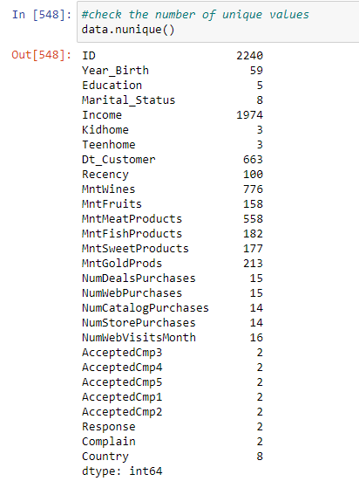
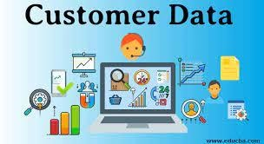

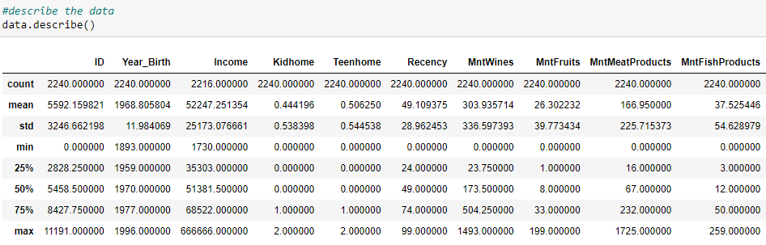
BASIC Statistics

Slide 3
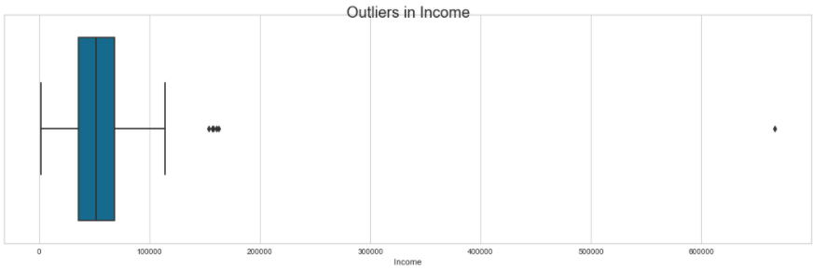
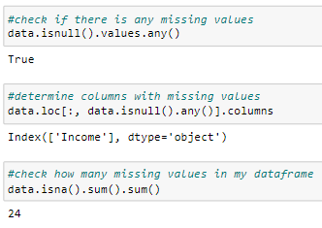
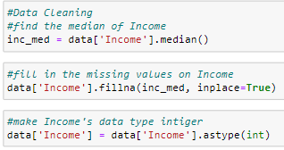
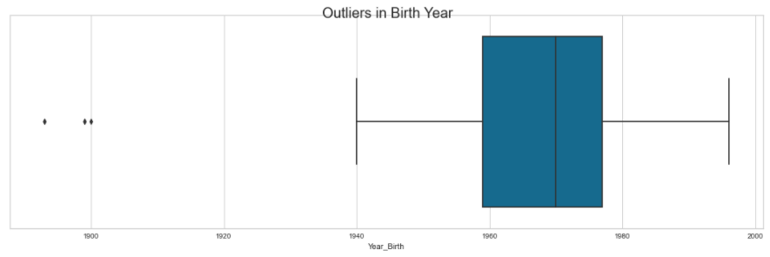
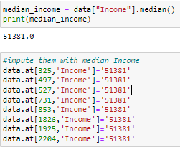
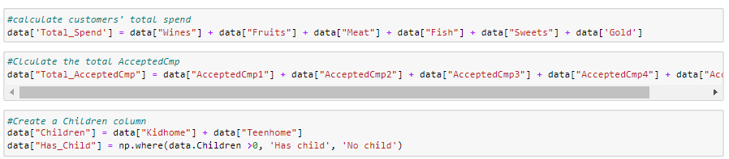
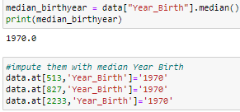
Data preparation
Missing Values
Handling Missing Values & Changing Data Type
Detecting Outliers
Creating New Valuable Variables
Imputing Outliers

Slide 4
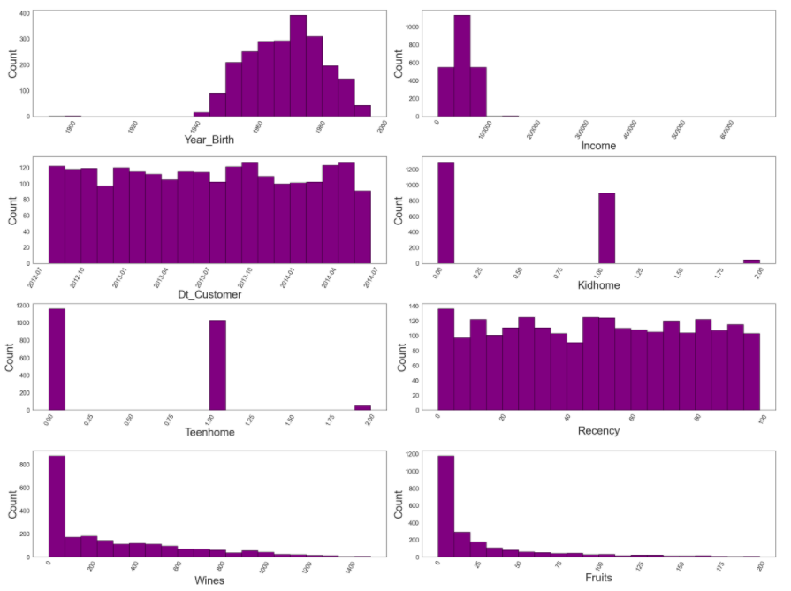
HISTOGRAMS Of Continuous variables: Part 1

Slide 5
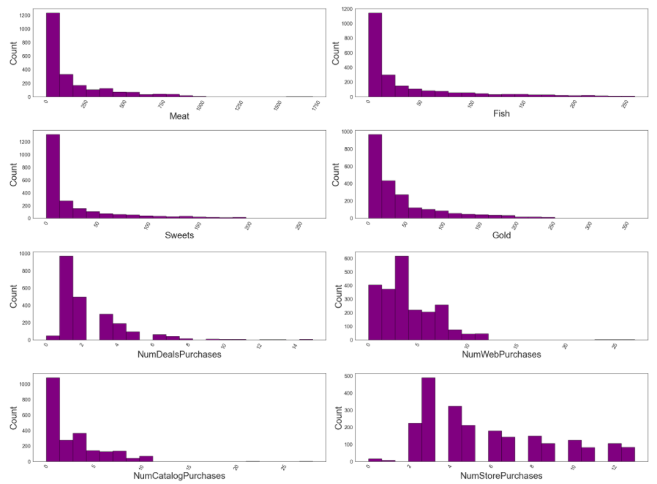
HISTOGRAMS Of Continuous variables: Part 2

Slide 6
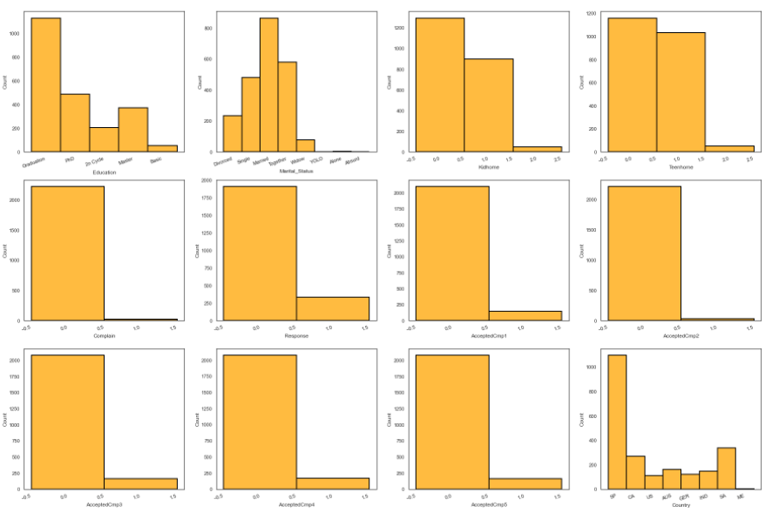
HISTOGRAMS Of Categorical variables: Part 1

Slide 7
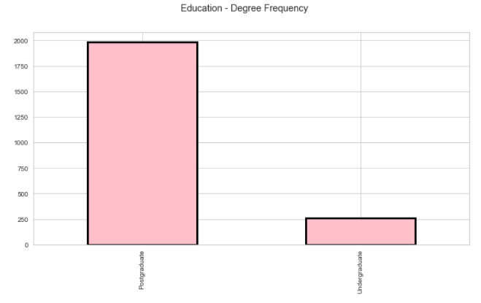
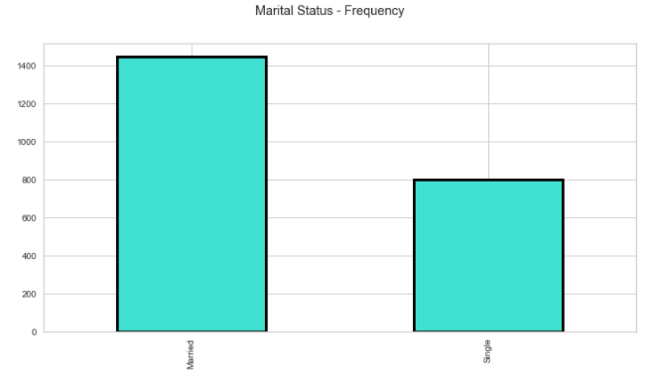
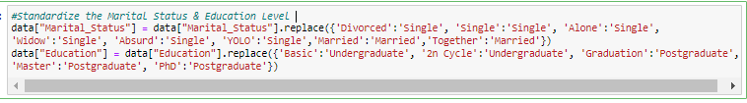
HISTOGRAMS Of Categorical variables: Part 2

Slide 8
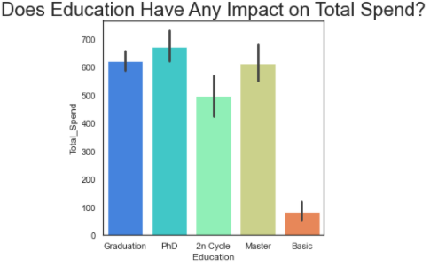
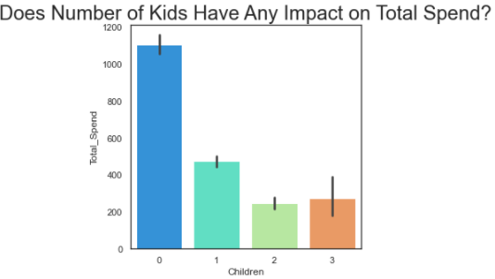
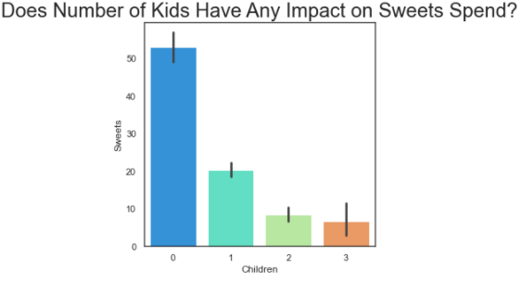
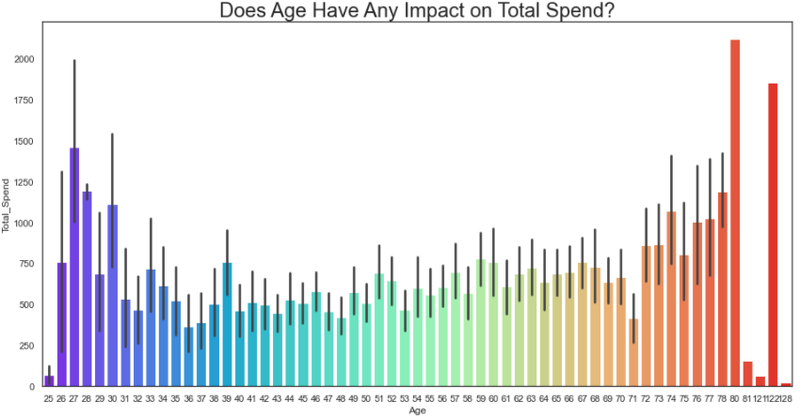
Dynamite bar plots: Part 1

Slide 9
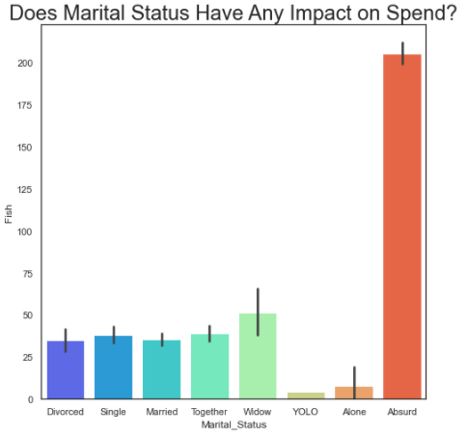
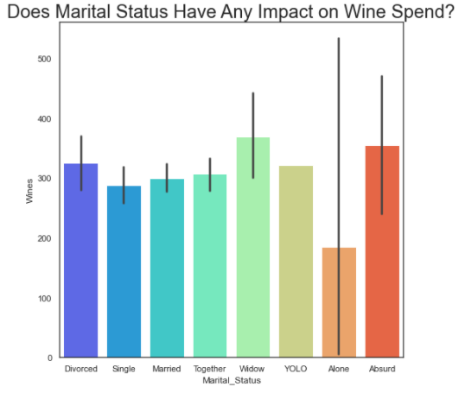
Dynamite bar plots: Part 2

Slide 10
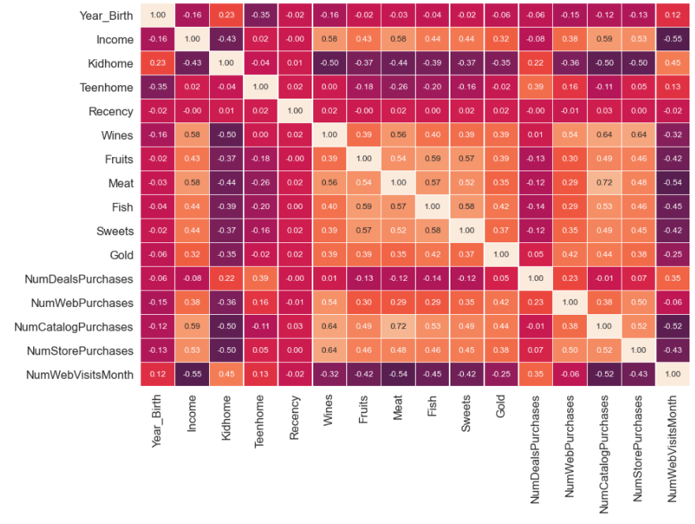

heatmap

Slide 11
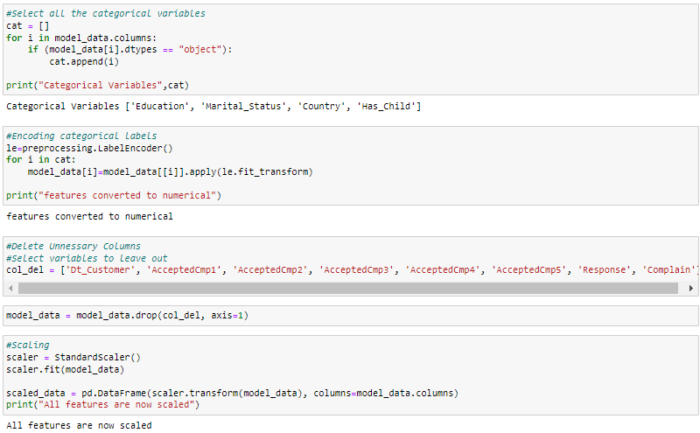
Data Preprocessing

Slide 12
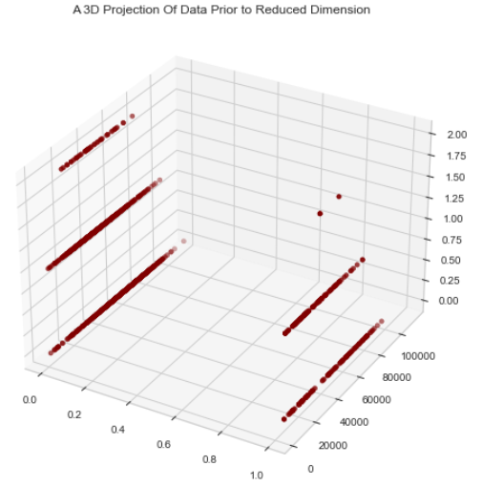
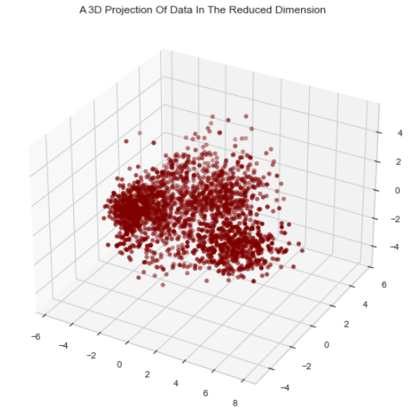
Dimensionality Reduction Using PCA

Slide 13
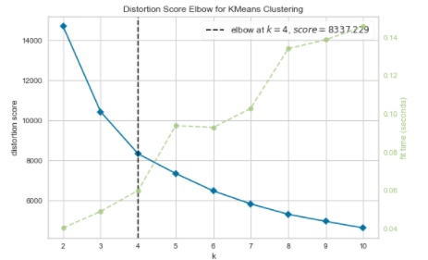
Choosing optimal Number of k

Slide 14
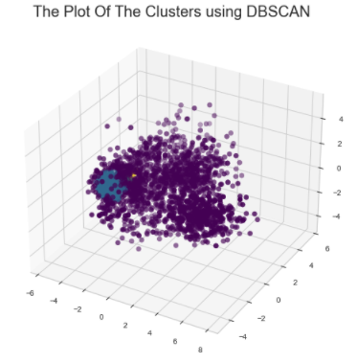
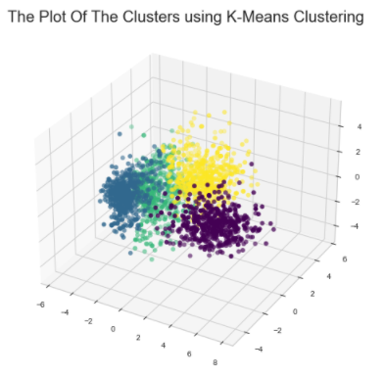
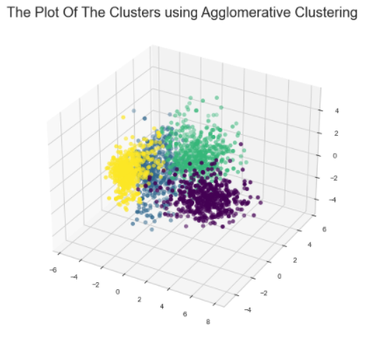
Modeling: clustering

Slide 15
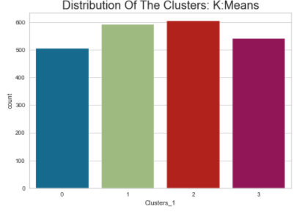
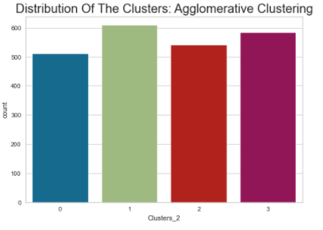
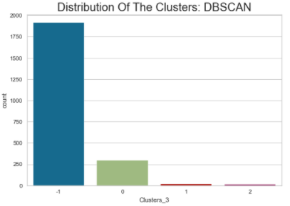
Model evaluation

Slide 16
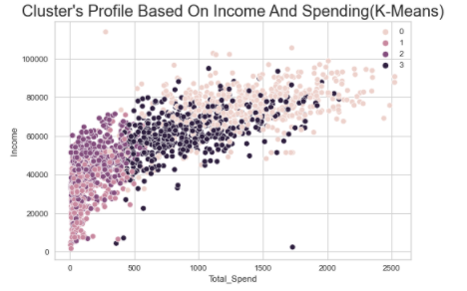
Group 0 & 3 spend more money on almost all types of products such as wine, sweets, fish and gold Group 1 & 2 on the other hands accepts & responds to more marketing campaign promotions Group 2 has highest number of Postgraduate degrees Group 1 has the highest number of undergraduate degrees Group 2 has highest number of complains Group 0 has the highest number of “no children” status
Analysis: Customer profiling
Group 0: high income & high spend
Group 1: low income & low spend
Group 2: average income & low spend
Group 3: average income & average spend

Slide 17
Recommendations (Q&A)
Do customers with higher income tend to spend more? Yes
Do customers who are older spend more on certain types of purchases such as wine? No, not necessary
Do variables such as education level have an impact on the spend? No
Which customers tend to spend more in certain categories of products such as sweets, wine and meat? People who are average & high earners spend more on everything.
Which customers will respond to marketing campaigns better? Group 1 & 2, in other words people who are low and average earners and spend low amounts respond to marketing campaigns better.
Which customers tend to shop in person vs. online? Group 0 & 3 make the largest number of in-store purchases, while only group 3 make the largest number of online purchases.
After looking at the various correlation plots as well as cluster visualizations we do have some good understanding on the characteristics of each cluster group. However, it is difficult to make recommendations that may result in increase in revenue for the company. The only conclusive information we can derive is that people who are average or high earners tend to spend more on all categories of products. People who are low and some of the average income earners respond better to marketing campaigns.

Slide 18
References:
Team, D. F. (2019, July 31). Data Science Project - Customer Segmentation using machine learning in R. DataFlair. Retrieved December 20, 2021, from https://data-flair.training/blogs/r-data-science-project-customer-segmentation/
Patel, A. (2021, August 22). Customer personality analysis. Kaggle. Retrieved December 20, 2021, from https://www.kaggle.com/imakash3011/customer-personality-analysis/code
Vardon, E. (2021, February 8). How to use Machine Learning for Customer Segmentation. Morphio. Retrieved December 20, 2021, from https://morphio.ai/blog/machine-learning-for-customer-segmentation/
Ryzhkov, E. (2020, July 23). 5 stages of data preprocessing for K-means clustering. Medium. Retrieved December 20, 2021, from https://medium.com/@evgen.ryzhkov/5-stages-of-data-preprocessing-for-k-means-clustering-b755426f9932
Solve customer segmentation with machine learning. Analytics Vidhya. (2021, August 27). Retrieved December 20, 2021, from https://www.analyticsvidhya.com/blog/2021/06/how-to-solve-customer-segmentation-problem-with-machine-learning

